Slide 1
AI-Altered Faces in Political Memes: A literature review of visual attention, emotion, and cognitive interpretation

Slide 2
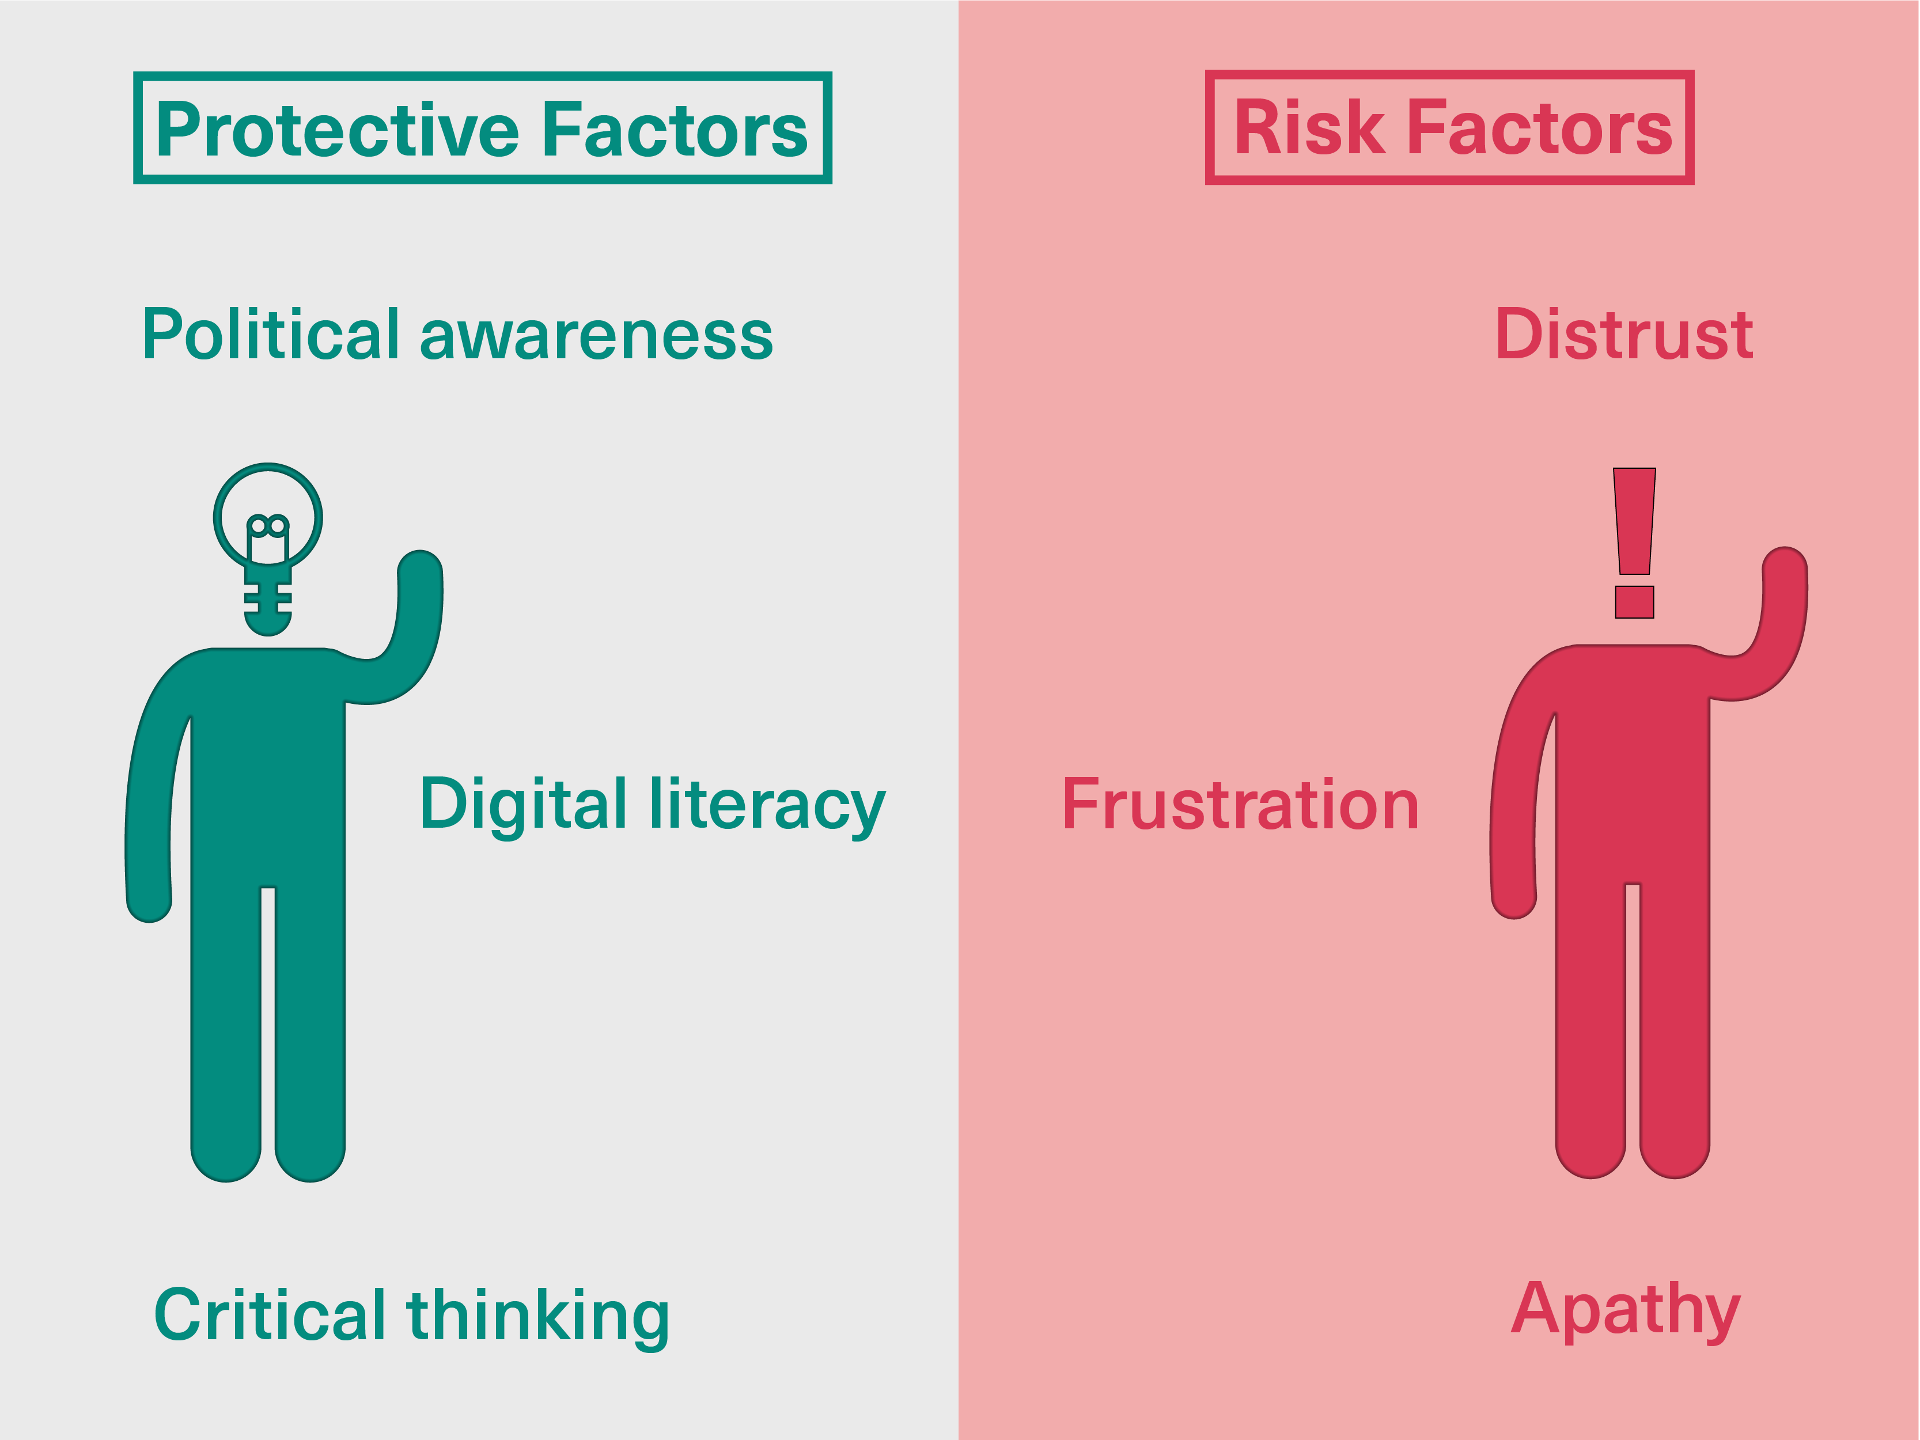
Background
Why This Topic Matters
Political memes combine images, text, humour and politics (Pataranutaporn et al. 73)
Faces are highly important social cues
AI can realistically manipulate facial appearance
Manipulation may change attention, emotion and interpretation
Limited research connects these areas directly
Notes:
Political memes are an essential tool for digital political communication as they integrate images, texts, punch lines and political elements in an accessible manner (Pataranutaporn et al. 73). Facial images are of special significance as they convey information about identity, emotion and social relevance. AI technologies are now able to edit and manipulate the appearance of people's faces and expressions in increasingly realistic ways, which could alter the emotional or social signals given out by politicians. These changes can impact what parts of a meme get attention and what the meme's message is understood to be. Prior studies on political memes and perception of faces have thus served as a useful starting point for understanding the potential impact of AI-manipulated facial content.
Another crucial factor is not to think of political memes just as humorous images. They can process multiple types of information simultaneously, for example, facial cues and written content, symbols and political cues. This becomes more complex when the face has been manipulated using AI, as the details might no longer reflect the genuine expression or look of the politician. It is, therefore, important to understand how the viewers react to these changed cues in order to understand modern digital political communication.

Slide 3
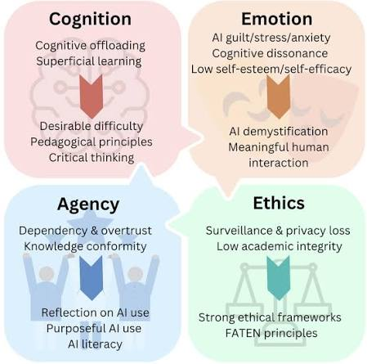
Research Problem
Existing research examines:
Face perception
Emotional facial processing
Visual attention
Political memes
AI-generated political images
But: Few studies examine AI-altered faces specifically within political memes (Islam et al. 47).
Notes:
Previous studies have yielded significant information on facial perception, emotional processing of faces, visual attention, and political meme interpretation. But these research areas have often evolved separately. New studies have also begun to focus on AI political visuals, including the aspects of authenticity, trustworthiness and detectability. However, relatively limited research has directly focused on AI-manipulated faces in political memes. This is an important research question because political memes are a multimodal text where facial information is combined with text, humour, and political context. To understand the interactions, it is necessary to determine how much AI-mediated facial manipulation alters cognitive processing beyond just making an image seem artificial (Islam et al. 47).
The primary question, therefore, is not just whether AI can produce realistic political images. The real question is what will happen when the changed faces are inserted into a full-blown political meme. A viewer might process the face first, then feel the mood of the expression and then read the written words. Meanwhile, the general meme can be interpreted based on pre-existing political opinions. This calls for a convergence between findings from psychology, visual communication, media generated by AI and political communication.

Slide 4
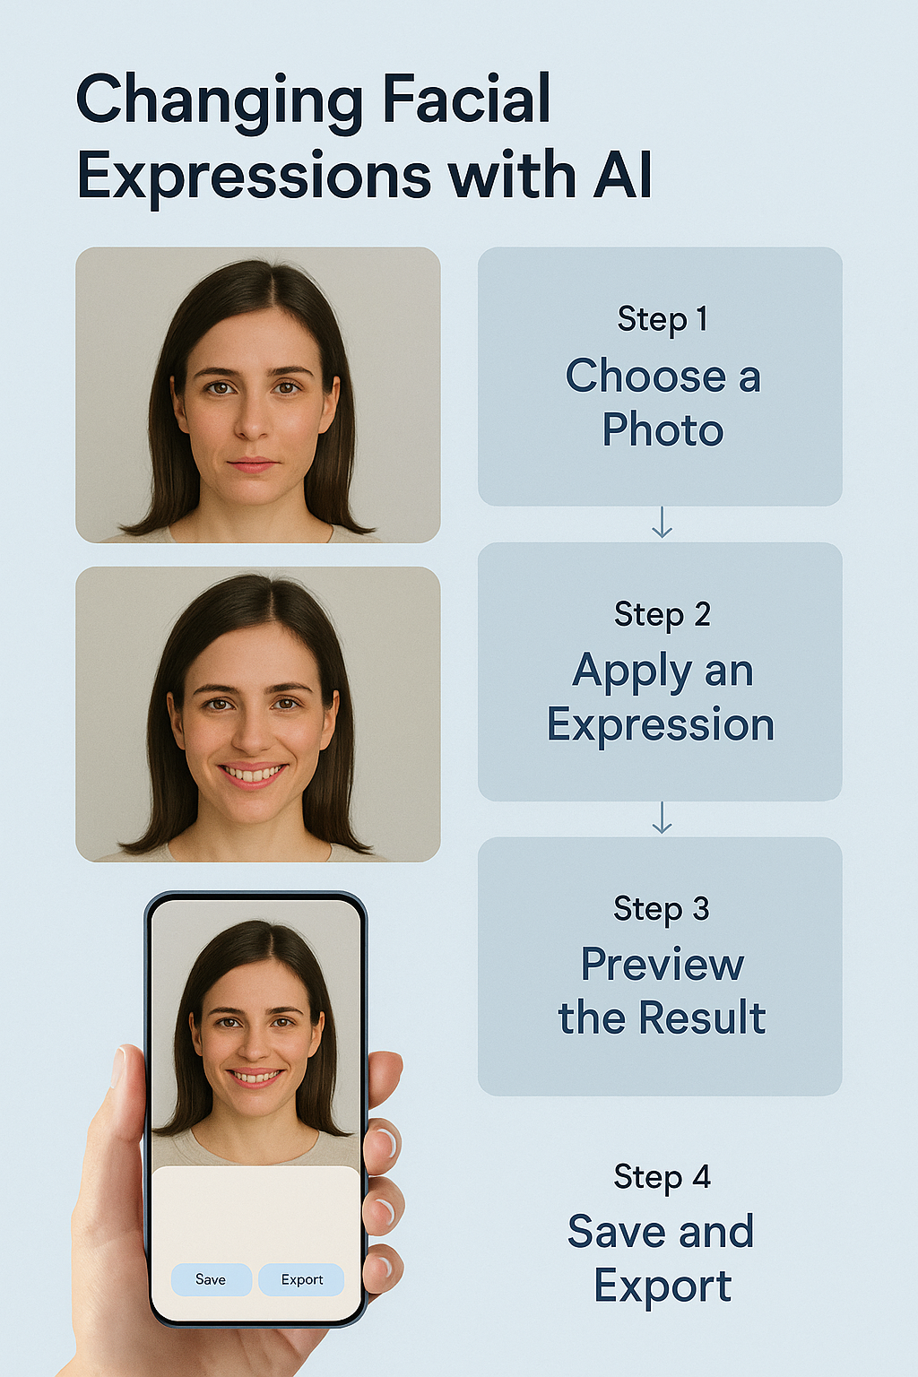
Main Research Question
Main Research Question
How do AI-altered facial images in political memes influence viewers' cognitive processing and interpretation?
Focus:
AI-altered face
↓
Attention + Emotion
↓
Cognitive interpretation
Notes:
The primary research question addresses the association between facially manipulated content in political memes processed via AI and cognitive processing by viewers. Cognitive processing refers to how viewers engage with information, how they have emotional responses, and how they use the visual and textual material to make meaning (Xu and Wise 53). The question does not presume that manipulated faces necessarily sway viewers or alter political opinions. Rather, it explores evidence about the psychological processes that might be involved in interpretation. The existing literature on facial perception, attention, emotions and created political images offers relevant evidence, and a literature review is conducted to assess the extent to which these findings can be translated to AI-manipulated faces in political memes.

Slide 5
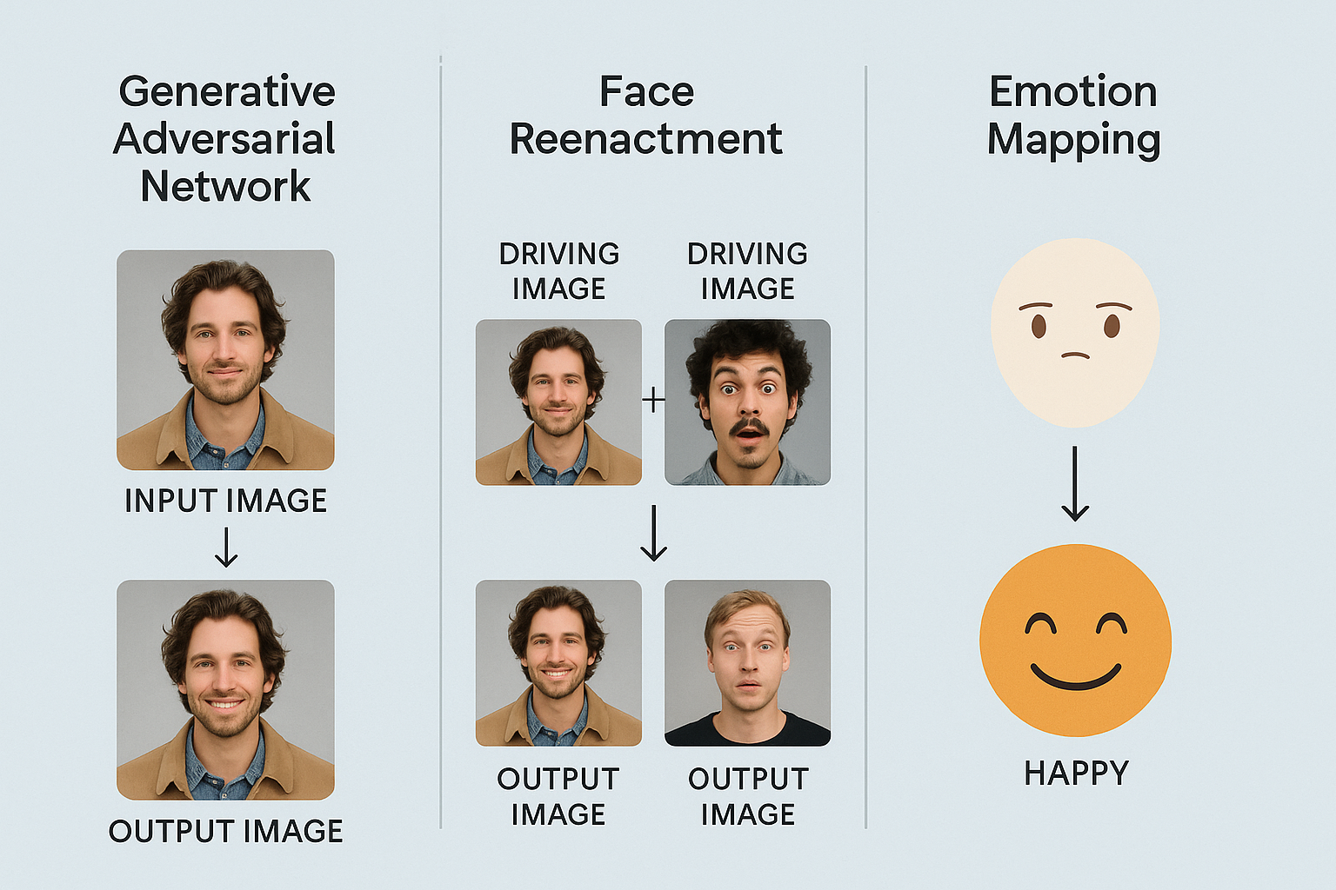
Research Questions
Detailed Research Questions
RQ1: How do AI-altered facial images in political memes influence viewers' cognitive processing and interpretation?
RQ2: How might AI-altered faces affect visual attention?
RQ3: How might manipulated expressions influence emotional responses?
Notes:
The research questions are well organised and follow a logical flow in the literature. The first question considers the psychological basis of perception of the face and how this relates to the interpretation of the political visual content. The second is specifically on whether altered facial features, produced by AI, could affect visual attention. The third asks the question of whether or not emotional responses can be altered by manipulated facial expressions. These questions, when combined, cover key aspects of thinking. The questions also provide a basis for identifying empirical evidence and research gaps (Eiserbeck et al. 55). This allows for a progression from existing knowledge in psychology to a more targeted and novel concept of AI-manipulated political meme faces.

Slide 6
Aim & Objectives
Research Aim: To critically examine how AI-altered facial images in political memes influence viewers' facial perception, visual attention, emotional responses, and cognitive interpretation.
Research Objectives
To examine how AI-altered facial images in political memes influence viewers’ cognitive processing and interpretation of political content.
To investigate how AI-altered facial features and faces affect viewers’ visual attention when viewing political memes.
To evaluate how manipulated facial expressions in political memes influence viewers’ emotional responses.
Notes:
The research aim is to critically analyse how facial perception, visual attention, emotional response and cognitive interpretation are altered by AI-generated edited facial images in political memes. The three objectives are directly related to the first three research questions. The first objective considers the known facts on face perception and political interpretation. The second evaluates evidence about visual attention towards altered facial imagery. The third measures emotional reactions to manipulated facial expressions. These objectives collectively give a clear direction to the literature review (Zhu et al. 32). They also assist in determining if prior research offers an adequate description of the relationship between facial manipulation and political meme interpretation.
The three objectives offer a framework for tackling the general research question. The first objective relates to interpretation and cognitive processing, the second to visual attention, and the third to emotional response. All of these goals acknowledge that reading a political meme isn't a matter of just viewing an image. The stages of attention, emotion and interpretation can function as a continuum of viewing. This structure also assists in keeping the research questions in relation to the themes found in the literature clear.

Slide 7
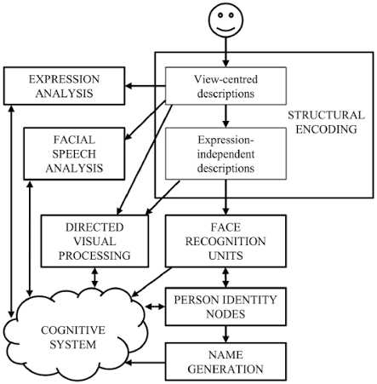
Facial Perception and Interpretation
Faces provide important identity and emotional information
Human perception processes faces as social stimuli
Facial features influence subsequent cognitive judgements (Scarpazza et al. 89)
Expressions communicate important affective information
AI can alter these perceptual signals
Notes:
Faces are a very significant type of social stimulus as they convey identity, emotional state and interpersonal attributes. Studies show that face perception requires specialised perceptual processes and is related to attention and emotional reaction. Facial expressions can have an impact on the interpretation of the intentions and qualities of another person (Scarpazza et al. 89). AI manipulation may alter facial identity cues, facial configuration or emotional expression, which may affect the information available to viewers. The changes are potentially especially important in political memes, where the face is read in conjunction with political words or other clues. Knowledge of existing face-perception research is therefore crucial for exploring the use of AI-manipulated political images.
Facial perception is especially relevant as viewers will naturally use faces to gain social information. Small changes to features such as the eyebrows, mouth or overall facial configuration can change the perceived emotional meaning of an expression. This could mean that these shifts can affect whether a politician is perceived as a certain kind of person before the viewer reads the language that goes with the image in an AI-altered political meme. But the face is not the only determinant of interpretation. The political background and the previous knowledge of the viewer can also affect the meaning given to the changed facial image.

Slide 8
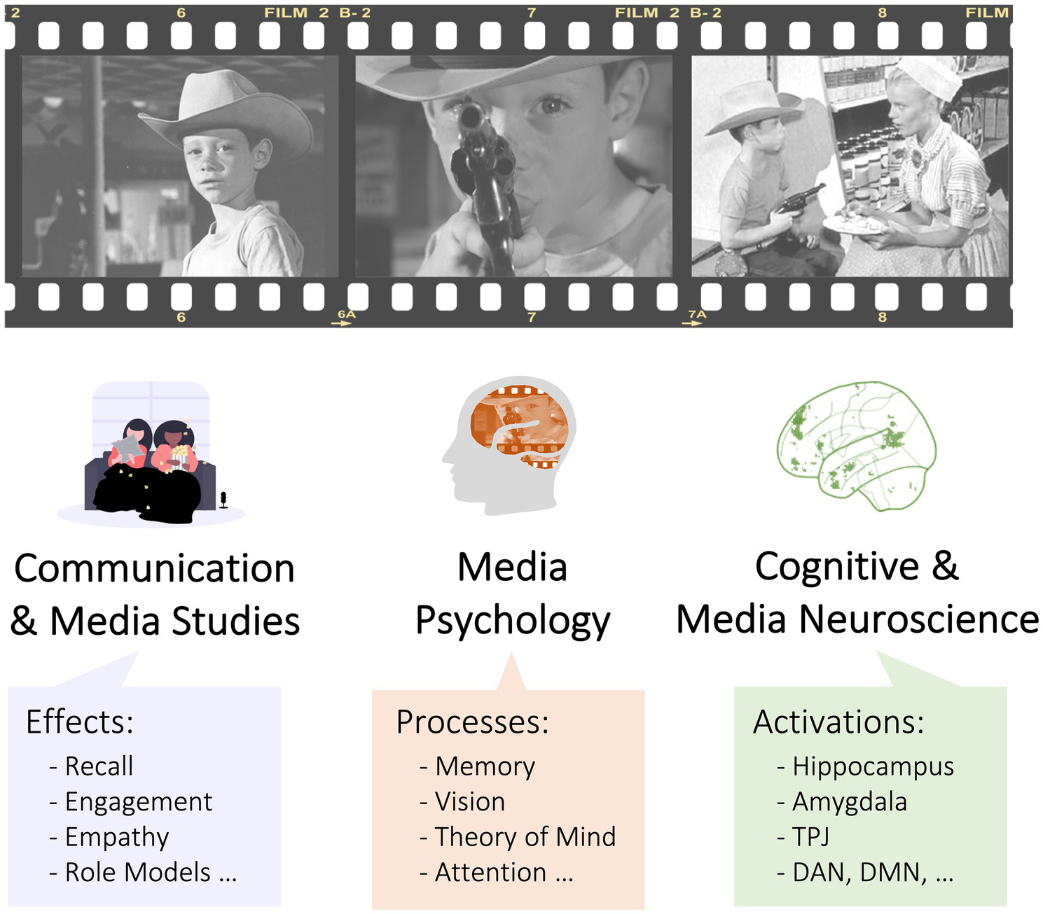
Visual Attention and Salience
Faces are generally highly salient visual stimuli
Emotional cues can influence attentional processing
Attention depends upon context and task relevance
AI manipulation may increase facial visual salience
Attention does not necessarily produce political persuasion (Lande et al. 125).
Notes:
How the visual system treats the different components of a complex image depends on what visual attention selects. Political memes typically have multiple layers, such as faces, text, backgrounds, symbols and other imagery (Lande et al. 125). However, the research suggests that emotional facial information can interact with attentional processes, but emotional faces do not always capture attention. Attention allocation depends on the relevance of the task and contextual factors. AI-manipulated faces might be more likely to capture attention if they are unusual or exaggerated and if they evoke emotional intensity. But more attention does not necessarily mean more persuasion. Attention is a crucial processing mechanism, and subsequent emotional and cognitive interpretation is needed.
The visual attention is significant because the audiences can't process all aspects of a complex meme at once. Faces are likely to stand out due to their socially significant information, and unusual or extreme transformations performed by the AI can make a face stand out. That does not, however, imply that the salience of the face will make it the dominant element in interpretation. The context, political message and viewing intention can shift the focus. This indicates that AI modification can impact gaze location, though in the broader context of the multimodal nature of the meme.

Slide 9
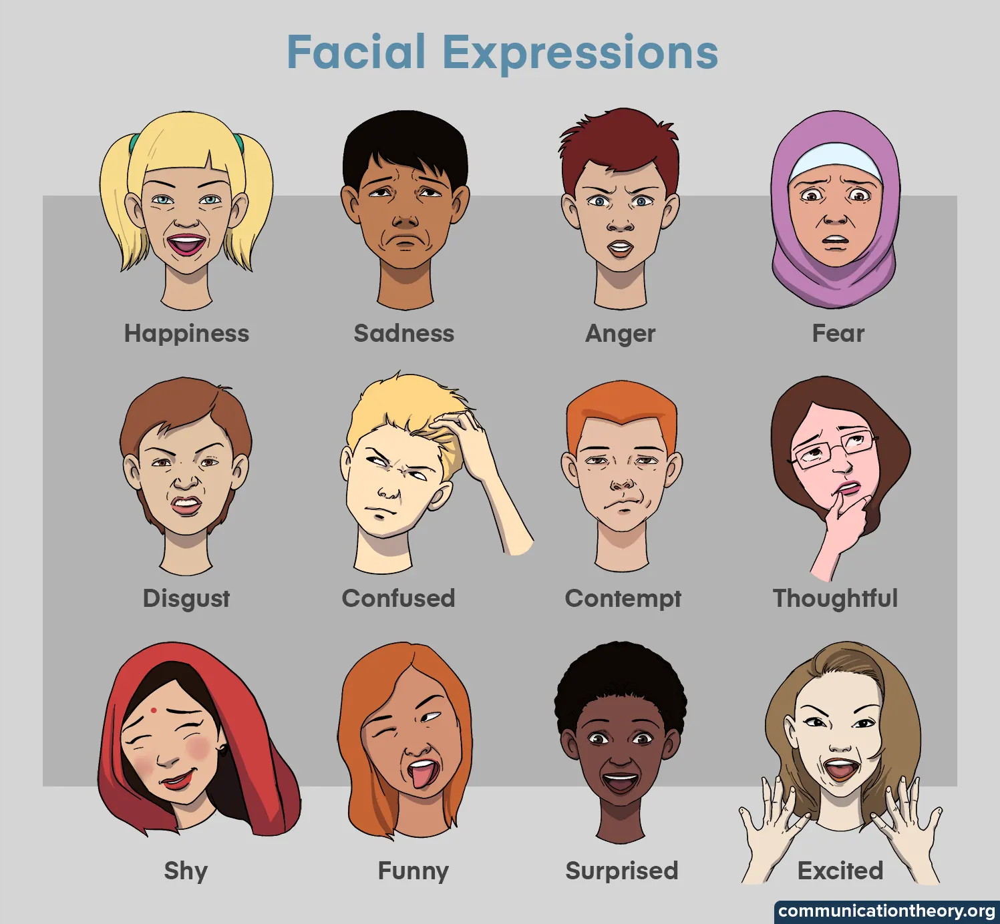
Emotional Processing of Faces
Facial expressions communicate important emotional information
Manipulation may amplify emotional facial signals
Anger may increase perceptions of political conflict
Fear may communicate threat or political vulnerability
Emotional responses can influence subsequent interpretation (Wang et al. 66).
Notes:
The emotional information that is communicated by facial expression can be important in the visual messages viewers make. Language related to anger, fear, happiness, disgust and sympathy is often used to convey specific impressions in the context of political communication. AI technologies could amplify or manipulate these emotional cues, which in turn affect the perception of a politician's expression. An exaggerated angry look can, for instance, reinforce perceptions of conflict, whereas a manipulated fearful look can convey vulnerability or threat. But surrounding context and accompanying text impact the emotional interpretation. For this reason, the emotional impact of an AI-modified face cannot be divorced from the broader political meme (Wang et al. 66).
Another significant bridge between the manipulation and interpretation of faces is emotional processing. A manipulated expression can accentuate the politician's anger, fear, confidence, or sympathy in the image. These changes may impact the attitude of the meme and, consequently, its political message. However, emotional responses are not likely to rely solely on the face. The accompanying language, wit, and political context can enhance or detract from the emotional response. For this reason, facial manipulation must be explored within the whole meme, not the individual image.

Slide 10
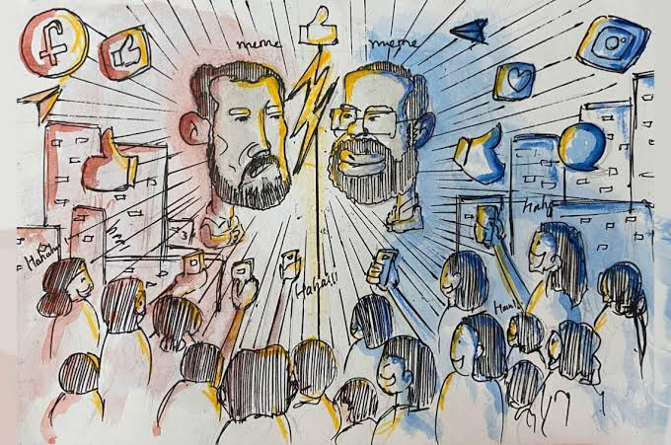
Political Meme Interpretation
Political memes combine images, text and humour
Political identity can influence meme interpretation
Partisan cues encourage motivated message processing (Bülow and Johann 45).
Political congruence can influence sharing intentions
Humour can increase engagement with political content
Notes:
Political memes are multimodal ways of communicating in which images, text, humour, and political identity interact. Past studies indicate that audience political ideology and partisanship can affect the assessment of political memes. The meanings of messages can vary based on whether a person's political message is congruent or inconsistent with what they already believe. Humour can also have a positive effect on engagement and sharing without having a significant impact on political attitudes (Bülow and Johann 45). These findings are relevant to the understanding of AI-manipulated faces because when the face is manipulated, it is another cue of information in an already complex message. The consequences of manipulation could hence be dependent on political identity and message situation and viewers' pre-existing attitude.
Political memes can thus be regarded as a multimodal message in which the elements contribute to the meaning. The facial expression may help convey the meaning of the text, or it may conflict with it or add another meaning. Political identity should also be taken into account, as viewers may understand the same meme differently depending on whether or not it aligns with their ideology.

Slide 11
Evidence Synthesis
Research Area | Evidence
Face perception | Strong evidence
Emotional processing | Strong evidence
Visual attention | Complex evidence
Political memes | Growing evidence
AI political imagery | Emerging evidence
AI-altered meme faces | Limited evidence
Key finding:
Existing research supports individual relationships
Integrated evidence remains comparatively limited
Notes:
There are relatively strong pieces of evidence in the literature on face perception and emotional processing of faces. The study of visual attention is more complicated because attention depends on the relevance of the task, the intensity of the emotion, and the context. The role of partisan identity, humour and multimodal processing is rapidly emerging in political meme research. Analyses of the use of political imagery created by AI are still in the process of development, yet they offer some early findings on issues of attention, emotion, credibility and authenticity. The major limitation is the lack of research integrating all these elements. Specifically, there are few empirical studies that directly explore the impact of AI-manipulated faces in political memes on both attention and emotional-cognitive processing (Zsidó, 96).
Evidence synthesis reveals that there is more literature in some areas than others. There is strong evidence of the relevance of facial perception and emotional processing, and evidence of visual attention is more context- and task-dependent. While political meme studies are evolving at a fast pace, the fusion of AI image manipulation of faces and political memes is understudied.

Slide 12
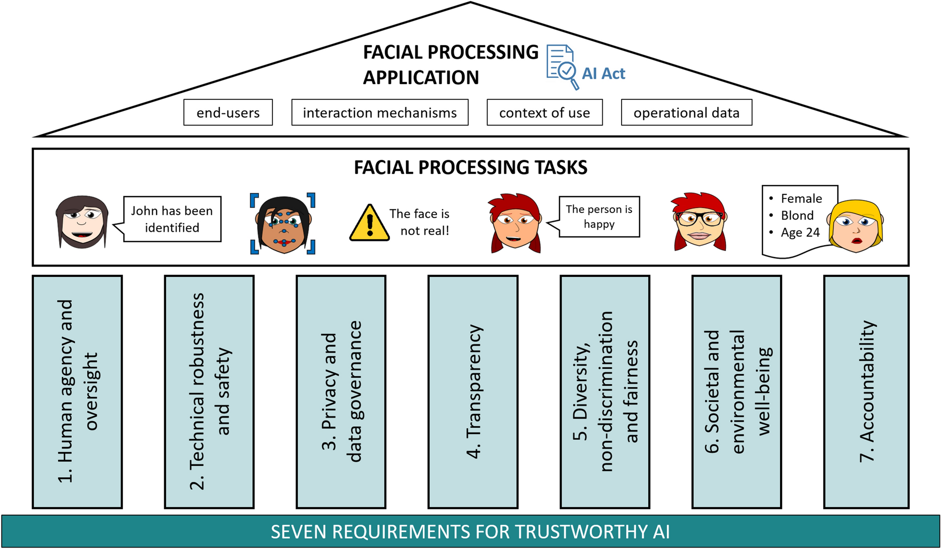
Research Gap
Identified Research Gaps
Limited integration between AI and face perception
Few studies isolate facial AI manipulation
Multimodal effects remain insufficiently investigated
Attention and emotion rarely measured together (Chen et al. 88).
Individual differences require greater research attention
Key gap: AI-altered faces within political memes remain under-researched.
Notes:
There are several key areas in the literature review that are not addressed. First, there are gaps in the research on the perception of the face, political memes and AI-generated images. Secondly, few studies focus on facial manipulation alone, as opposed to synthetic images or videos. Thirdly, more attention needs to be paid to the interplay between manipulated faces, meme text and political context. Fourth, there are no consistent examinations of visual attention and emotional response in conjunction with cognitive measures like credibility or authenticity. Finally, political ideology and AI literacy may impact responses and should be explored further. These gaps indicate the need for research specifically targeting AI-manipulated faces in realistic political-meme settings (Chen et al. 88).

Slide 13
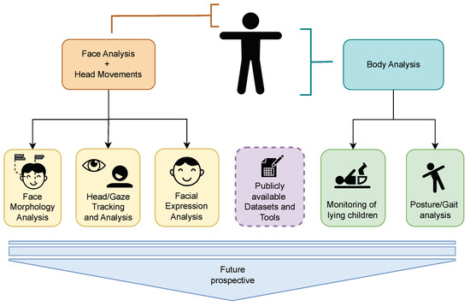
Proposed Future Empirical Study
Potential Research Design
Experimental design comparing different facial conditions (Liu et al. 2024)
Questionnaires could assess emotional responses
Political ideology could examine individual differences
Possible conditions:
Original face
AI-altered neutral face
AI-altered emotional face
Notes:
A future experimental study with political memes with different facial conditions might help fill the identified literature gap. The participants were able to see original faces and AI-manipulated neutral and emotionally manipulated faces. Eye-tracking might be used to measure visual attention via fixation duration, frequency and pattern. Questionnaires might measure emotional reaction, perception of credibility, authenticity & interpretation of the political message. Potential moderating effects include political ideology and AI literacy. AI disclosure may also be used to see how responses vary with or without synthetic content being disclosed. This will directly link the psychological mechanisms found in literature (Liu et al. 146).

Slide 14
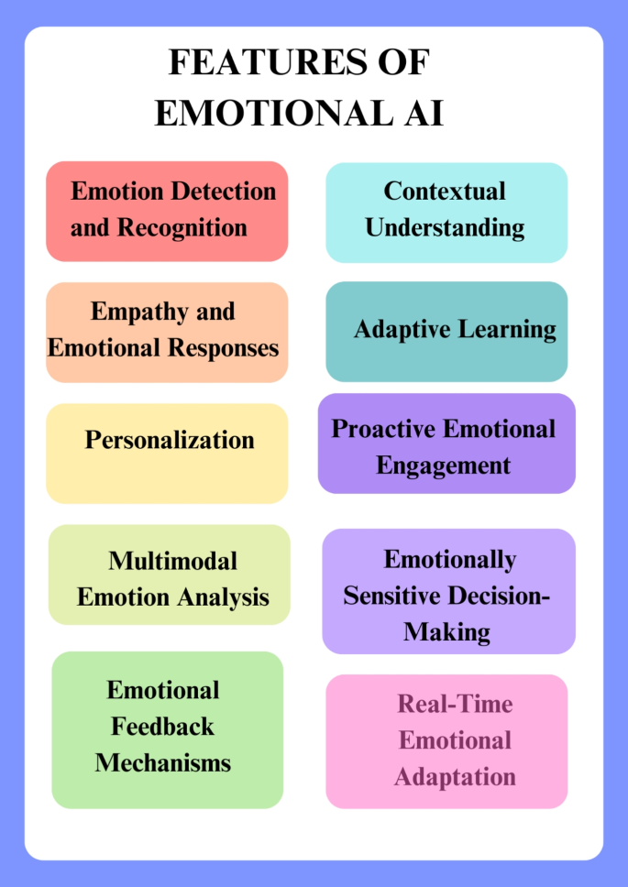
Conclusion
Faces influence visual and emotional processing
Political memes involve complex multimodal interpretation
AI can manipulate facial and emotional cues
AI imagery may influence attention and credibility
Direct evidence remains limited and inconclusive
Key Takeaway: AI-altered faces may shape what viewers notice, feel and interpret.
Notes:
The literature shows that facial information is important in visual and emotional processing and that political memes are complexly combined images and texts with humour and political contexts. AI technologies introduce additional possibilities for altering facial identity and emotional signals. New studies indicate that AI can manipulate political imagery to drive attention, emotion, trust and perceptions of authenticity. But there is not enough direct evidence about AI-manipulated faces in political memes at this time. The literature available indicates that there is thus a need for more empirical research and does not necessarily conclude anything about political persuasion. Future studies will focus on attention, emotion and cognitive interpretation in real multimodal political contexts.

Slide 15
References
Bülow, Laura, and Michael Johann. “Effects and Perception of Multimodal Recontextualization in Political Internet Memes: Evidence from Two Online Experiments in Austria.” *Frontiers in Communication*, vol. 7, 2023, article 1027014, https://doi.org/10.3389/fcomm.2022.1027014
Chen, Zhenhui, et al. “Synthetic Politics: Prevalence, Spreaders, and Emotional Reception of AI-Generated Political Images on X.” *Proceedings of the 36th ACM Conference on Hypertext and Social Media*, Sept. 2025, pp. 11–21, https://doi.org/10.1145/3720553.3746675
Eiserbeck, Anja, et al. “Deepfake Smiles Matter Less—the Psychological and Neural Impact of Presumed AI-Generated Faces.” *Scientific Reports*, vol. 13, no. 1, 2023, article 16111, https://doi.org/10.1038/s41598-023-42802-x
Islam, Muhammad B. E., et al. “AI Threats to Politics, Elections, and Democracy: A Blockchain-Based Deepfake Authenticity Verification Framework.” *Blockchains*, vol. 2, no. 4, 2024, pp. 458–481, https://doi.org/10.3390/blockchains2040020
Lande, R. S., A. P. Bhagat, and P. A. Khodke. “Current Challenges and Open Issues for Multimodal Visual Memes Content Analysis.” 2025, https://oeilresearch.com/wp-content/uploads/50-ORJ1795.pdf
Liu, F., et al. “When Citizens Support AI Policies: The Moderating Roles of AI Efficacy on AI News, Discussion, and Literacy.” *Journal of Information Technology & Politics*, vol. 21, no. 4, 2024, pp. 493–509, https://doi.org/10.1080/19331681.2023.2294363
Pataranutaporn, Pat, et al. “Synthetic Human Memories: AI-Edited Images and Videos Can Implant False Memories and Distort Recollection.” *Proceedings of the 2025 CHI Conference on Human Factors in Computing Systems*, Apr. 2025, pp. 1–20, https://doi.org/10.1145/3706598.3713697.
Scarpazza, Cristina, et al. “The Emotion Authenticity Recognition (EAR) Test: Normative Data of an Innovative Test Using Dynamic Emotional Stimuli to Evaluate the Ability to Recognise the Authenticity of Emotions Expressed by Faces.” *Neurological Sciences*, vol. 46, no. 1, 2025, pp. 133–145, https://doi.org/10.1007/s10072-024-07689-0.
Wang, J. Z., et al. “Unlocking the Emotional World of Visual Media: An Overview of the Science, Research, and Impact of Understanding Emotion.” *Proceedings of the IEEE*, vol. 111, no. 10, 2023, pp. 1236–1286, https://doi.org/10.1109/JPROC.2023.3272408
Xu, X., and K. Wise. “Human vs Artificial Newscasters: Divergent Effects on Viewer Attention and Emotional Processing.” *International Journal of Human–Computer Interaction*, vol. 42, no. 12, 2026, pp. 9526–9545, https://doi.org/10.1080/10447318.2025.2578395
Zhu, A., et al. “How Brow Rotation Affects Emotional Expression Utilising Artificial Intelligence.” *Aesthetic Plastic Surgery*, vol. 47, no. 6, 2023, pp. 2552–2560, https://doi.org/10.1007/s00266-023-03615-5.
Zsidó, A. N. “The Effect of Emotional Arousal on Visual Attentional Performance: A Systematic Review.” *Psychological Research*, vol. 88, no. 1, 2024, pp. 1–24, https://doi.org/10.1007/s00426-023-01852-6

Slide 16
THANK YOU

